Slide 1

Comparative study of various algorithms on
Hyperspectral Data
Submitted BY:
Payas Deshpande
Manas Rode
Meet Raychura
Sridhar Subramanian

Slide 2
Introduction
•Introduction Hyperspectral Imaging:
Hyperspectral imaging involves capturing and processing information from a wide range
of electromagnetic spectra. Helps in various activities.
•Significance of Hyperspectral Image Classification:
The correct classification of hyperspectral pictures is essential for deriving significant insights from intricate databases.
•Introduction to CNN:
CNNs' capacity to automatically extract hierarchical features from input has revolutionized image processing and classification jobs.
•Datasets Under Consideration:
Pavia University (PU): Pavia in northern Italy through a Reflective Optics System Imaging Spectrometer (ROSIS)optical sensor during a flight campaign. A 103 hyperspectral images of size 610x340 with 103 bands with 9 Classes of surface.
Salinas-A (SA): A dataset was acquired over Salinas Valley California, through an Airborne Visible/Infrared Imaging Spectrometer (AVIRIS) sensor. A 16 different types of crops grown in an agricultural scene with 512x217 pixels and with 224 bands.
Indian Pines (IP): A dataset is acquired using an AVIRIS sensor over the northwestern Indiana test site. A 145×145 spatial dimensions and 224 spectral dimensions with a total of 16 classes

Slide 3
Literature Survey
Sr no. | Title | Publication & Year | Dataset | Objective | Models | Performance
1. | Regularized CNN Feature Hierarchy for Hyperspectral Image Classification | MDPI, 2021 | IP, SA, PU | Idea to improve CNN's generalization capabilities for HSIC by utilizing uniform distribution of ground labels and soft labels, which are a weighted average of the hard labels. The suggested approach aids in preventing CNN from being overconfident. | (a) 2D-CNN (b) 3D CNN (c) AlexNet (d) LeNet (e) Hybrid | IP ==> 2D-CNN = 98.94%; 3D CNN = 91.57%; Hybrid = 99.29%. SA ==> 2D-CNN = 99.9876%; 3D CNN = 99.9794%; Hybrid = 100.0% PU ==> 2D-CNN = 99.9070%; 3D CNN = 99.9256%; Hybrid = 99.9628%
2. | Hyperspectral Image Classification: Artifacts of Dimension Reduction on Hybrid CNN | Cornell University, 2021 | IP, SA, PU, SFS (Salina Full Scene) , PAVIA Center | suggested a lightweight CNN (3D and then 2D) model that distributes spatial-spectral feature extraction over a lighter model with additional preprocessing to enhance the classification outcomes, hence reducing the computational cost considerably. | CNN (Hybrid Model 3D/2D) | Proposed 3D-CNN to 2D-CNN SA + SFS = 99.90 IP = 97.23 PU = 99.71 Botswana = 97.91

Slide 4
Sr no. | Title | Publication & Year | Dataset | Objective | Models | Performance
3. | Hyperspectral image classification using CNN with spectral and spatial features integration | Elsevier, 2020 | IP, SA, PU | To create a Fused features to apply CNN | CNN | Accuracy for the Proposed Model SA = 0.9994 IP = 0.9902 PU = 0.9994
4. | ResMorCNN Model: Hyperspectral Images Classification Using Residual-Injection Morphological Features & 3D-CNN Layers | IEEE, 2023 | IP, SA, PU, Hoston University (HU) | The ResMorCNN model extracts forms, interregional interactions, and structural data from HSIs by using 3D convolutional layers and morphology mathematics. | CNN, ResMorCNN | OA (Overall Average) Proposed ResMorCNN SA = 0.9971 IP = 0.9781 PU = 0.9933
5 | PiCovS: Pixel-Level With Covariance Pooling Feature and Superpixel-Level Feature Fusion for Hyperspectral Image Classification | IEEE, 2023 | IP, SA, PU | a novel covariance pooling technique with an attention mechanism within the CNN branch, enabling the gathering and application of holistic HSI information along spectral and spatial dimensions. | CNN, GCN | SA = 99.98 IP = 99.84 PU = 99.97

Slide 5
Libraries Used
GDal:
GDAL, the Geospatial Data Abstraction Library, is a comprehensive open-source library for reading and writing raster and vector geospatial data formats.
Sklearn:
Sklearn is a machine learning library for the Python programming language. It features various classification, regression, clustering, and dimensionality reduction algorithms, including support vector machines, random forests, gradient boosting, k-means, etc.
Matplotlib:
Matplotlib is a comprehensive library for creating static, animated, and interactive visualizations in Python. It provides a wide range of plotting functions to create a variety of charts, graphs, and visualizations, including line plots, bar charts, scatter plots, histograms, and more.
SkImage:
Load the image

Slide 6
Applications
Urban planning and development
Residential
Commercial
Industrial area
Agriculture
Identify different types of crops
To monitor the health and growth of Crops.
Forestry (Deforestation and Targeted Afforestation):
Biodiversity Conversion:
Forestry
Deforestation and Targeted Afforestation

Slide 7
Data Description
 | Indian Pines | Pavia University | Salinas Data | Other Dataset : From Kaggle, Google Earth
Location | Indiana (USA) | Pavia, northern Italy | Salinas Valley, California | Poland, Central Europe
Data Type | Hyperspectral | Hyperspectral | Hyperspectral | Multi Spectral
Number Of Bands | 220 | 115 | 224 | 3
Bands in Corrected Data | 200 | 103 | 204 | 3
Total Classes | 16,Wheat,Soybean-clean,Oats,Corn,Grass-trees etc. | 9,Asphalt,Meadows,Gravel,Trees,,Bare Soil etc. | 16,Brocoli_green_weeds_1,Grapes_untrained,Lettuce_romaine_4wk etc. | 4
Spatial Resolution | 20 m | 1.3 m | 3.7 m | 25 cm
Total No of Pixels | 145*145=21025 | 610, 340=207400 | 512, 217=111104 | -
File Format Used | .mat File | .mat File | .mat File | Geo Tiff

Slide 8
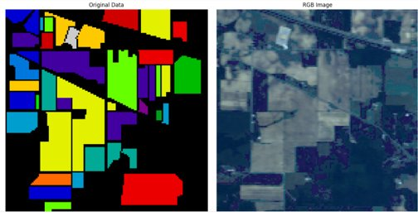
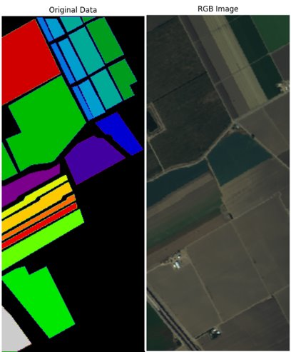
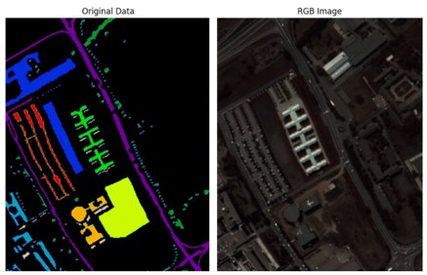
Data Visualization
Indian Pines
Salinas Dataset
Pavia University

Slide 9
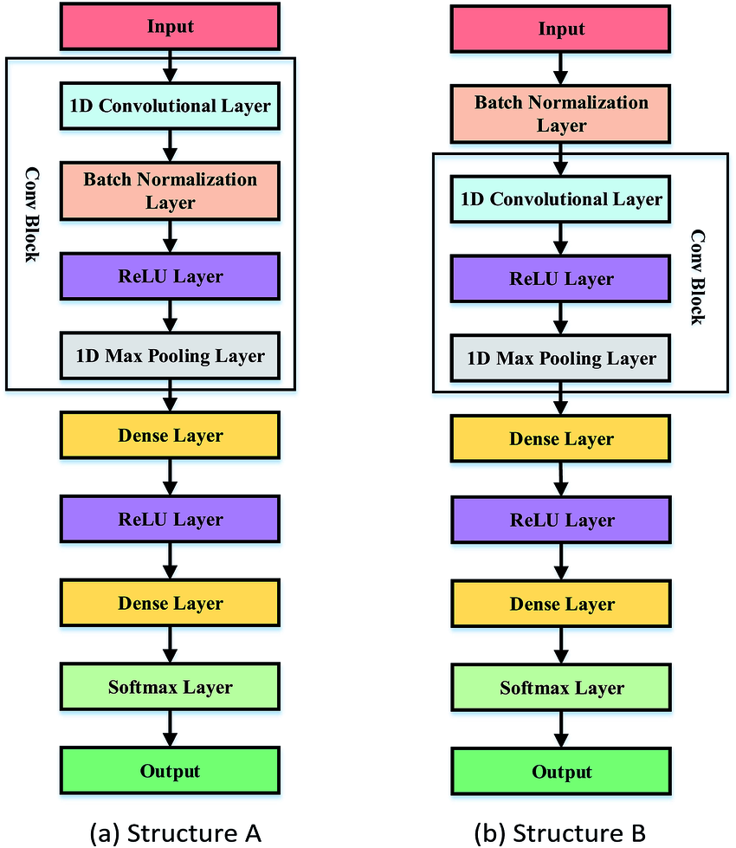
Methodology

Slide 10
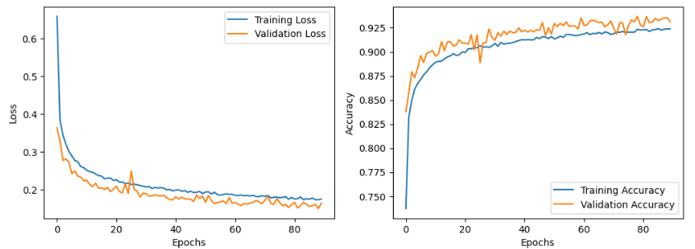
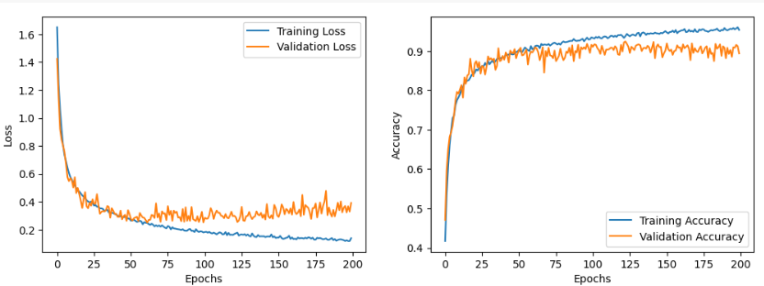
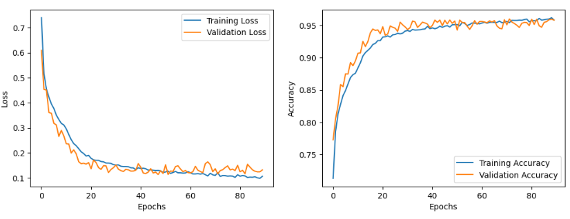
Results :
Evaluation Matrix | Accuracy | Precision | Recall
Datasets
Salinas | CNN:0.9351 RF:0.9491 SVC:0.9192 | CNN:0.9353 RF:0.9568 SVC:0.9220 | CNN:0.9362 RF:0.9409 SVC:0.9169
Pavia | CNN:0.948 RF:0.9124 SVC:0.9221 | CNN:0.9489 RF:0.9397 SVC:0.9222 | CNN:0.9485 RF:0.9194 SVC:0.9225
Indian Pines | CNN 1D:0.9102 CNN 2D:0.9831 RF:0.7721 SVC:0.8902 | CNN:0.9113 RF:0.9314 SVC:0.8952 | CNN:0.9103 RF:0.7724 SVC:0.8904
Results of Training of Salinas Dataset(1-D CNN)
Results of Training of Indian Pines Dataset(1-D CNN)
Results of Pavia Dataset(1-D CNN)

Slide 11
Thank You

